Slide 1

A Bayesian observer model constrained by efficient coding can explain ‘anti-Bayesian’ percepts
Xue-Xin Wei & Alan A Stocker
Speaker: Yingjie Huang

Slide 2
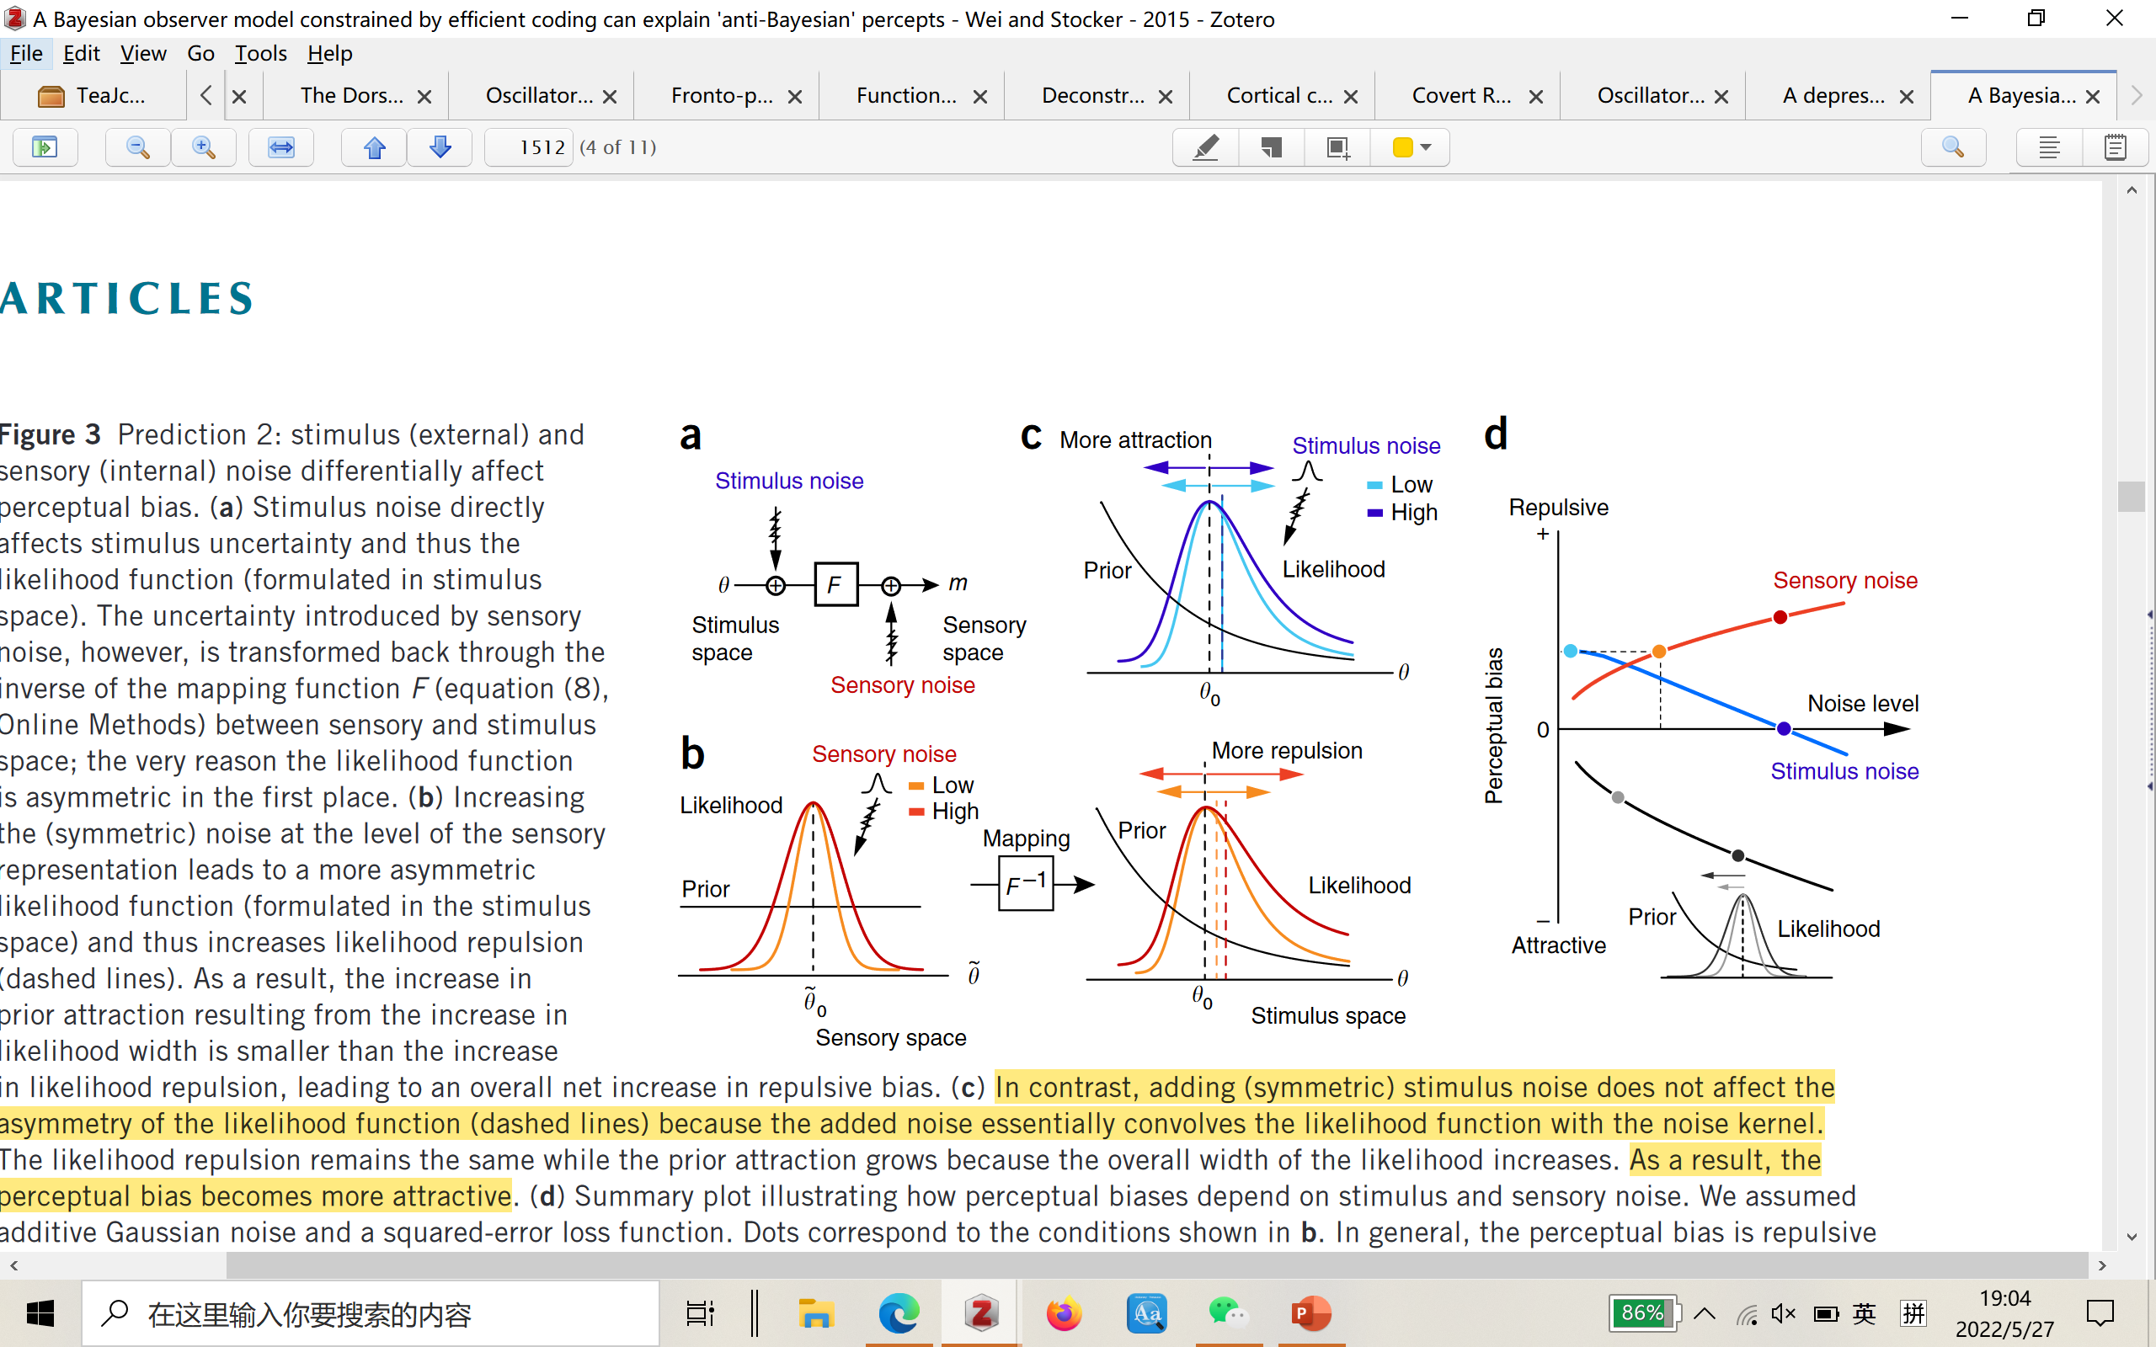
Anti-Bayesian Effect
the perceptual bias is repulsive and grows with increasing sensory noise
increasing stimulus noise reduces the repulsive bias, eventually leading to attractive biases for large noise levels
the black curve illustrates the expected biases for a Bayesian observer model that a priori assumes a symmetric likelihood function

Slide 3
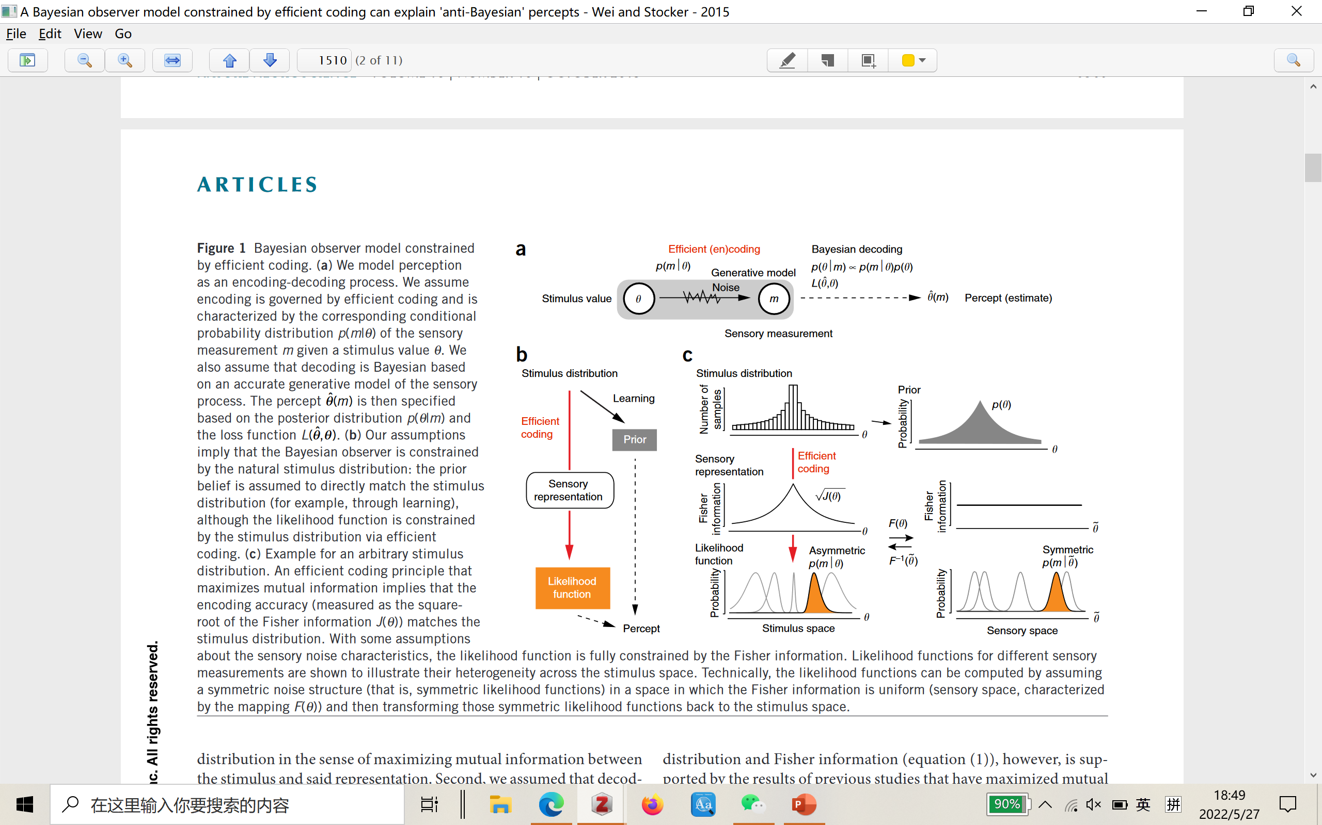
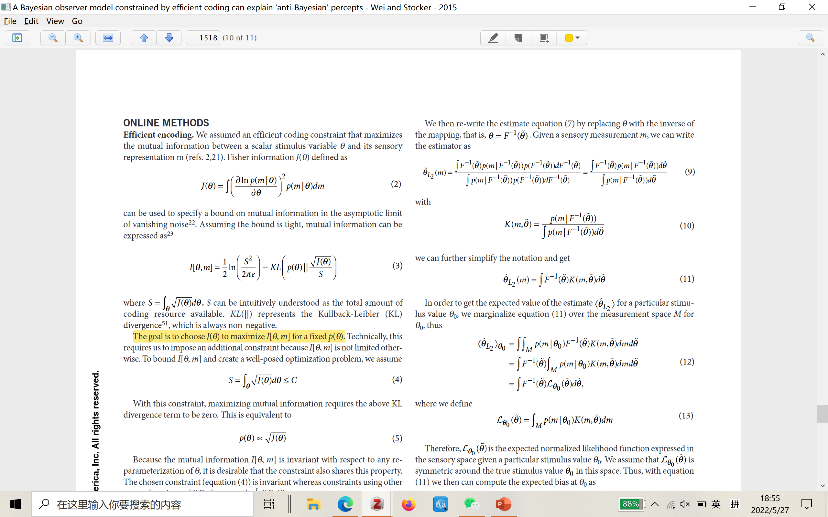
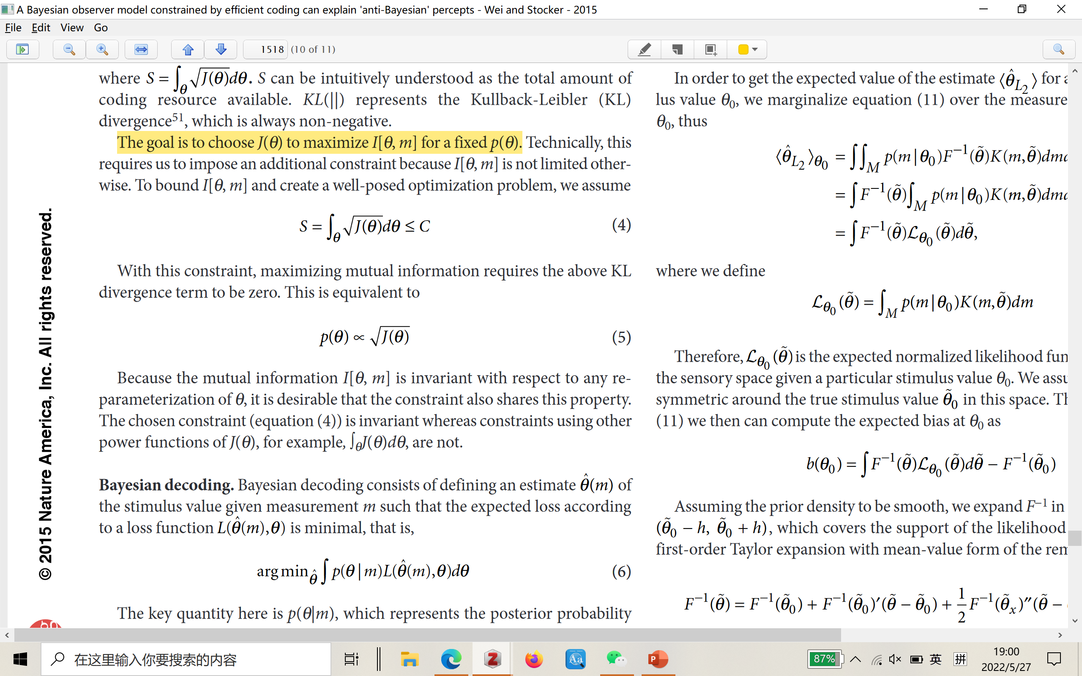
Efficient (en)coding

Slide 4
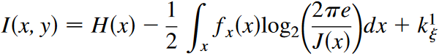
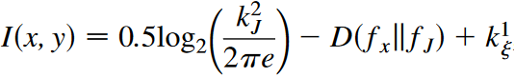
Mutual information

Slide 5
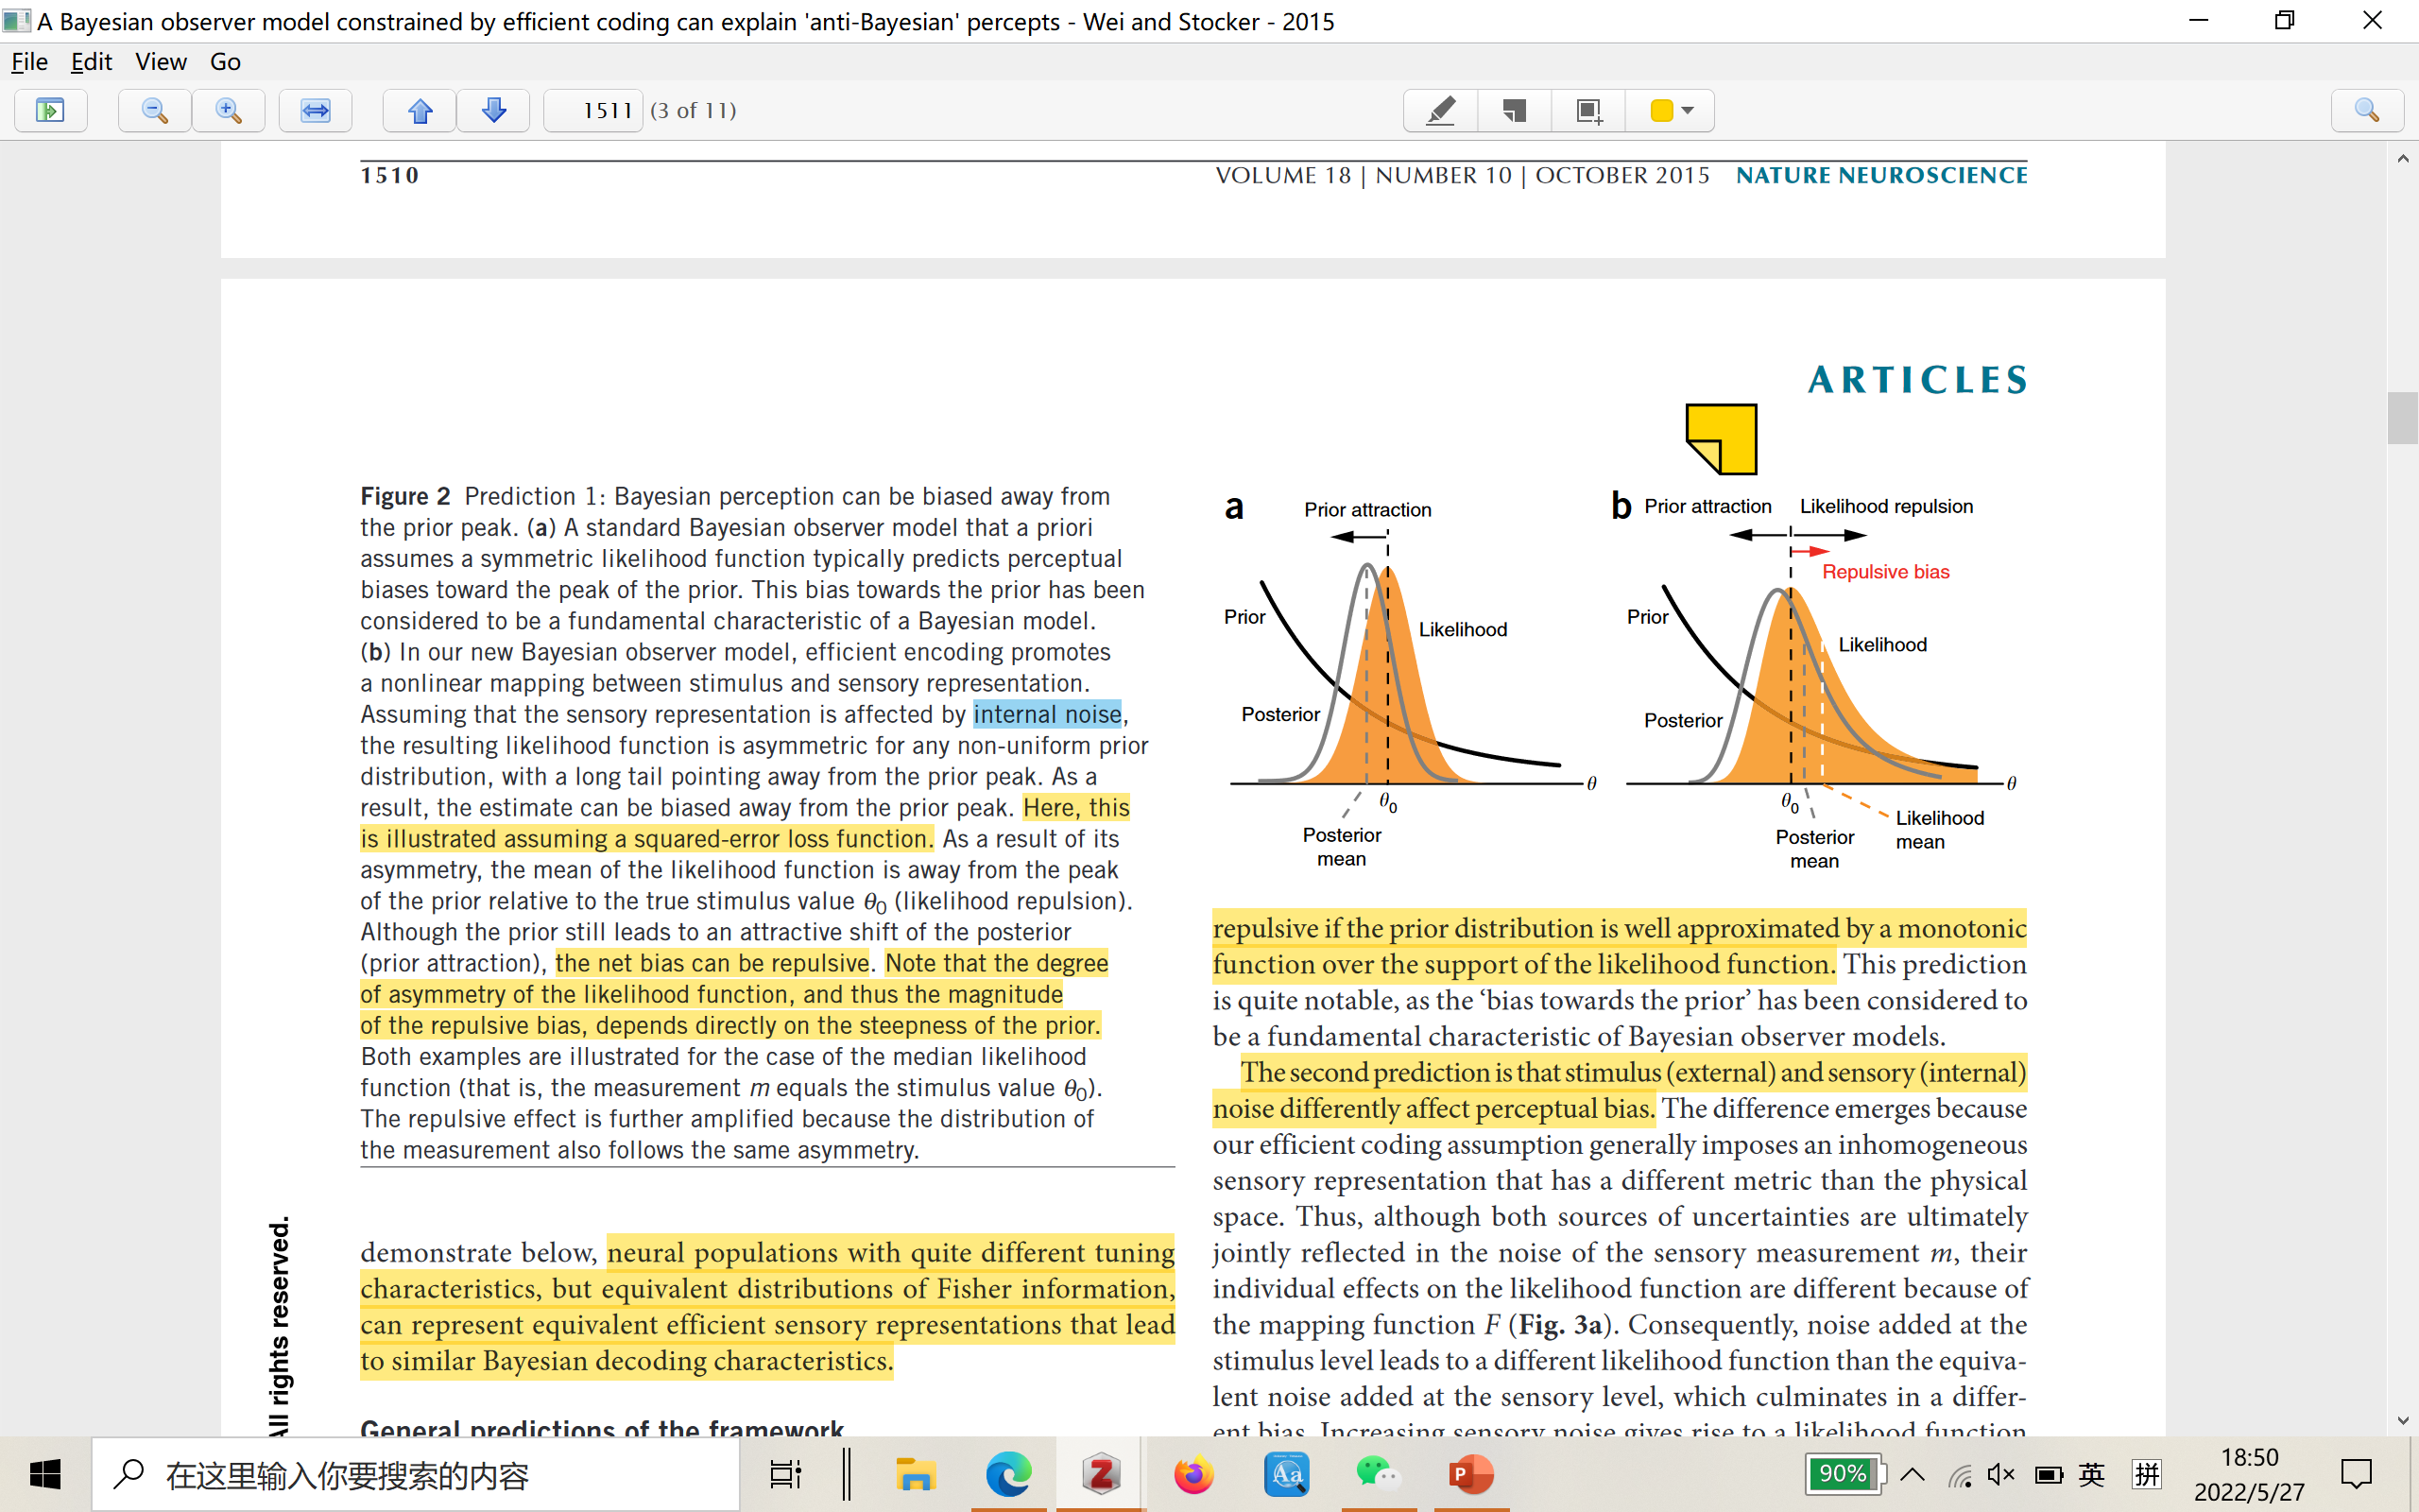
Bayesian Observer Model
A standard Bayesian observer model that a priori assumes a symmetric likelihood function typically predicts perceptual biases toward the peak of the prior
In a new Bayesian observer model, efficient encoding promotes a nonlinear mapping between stimulus and sensory representation. Assuming that the sensory representation is affected by internal noise, the resulting likelihood function is asymmetric for any non-uniform prior distribution, with a long tail pointing away from the prior peak.
As a result, the estimate can be biased away from the prior peak

Slide 6
Prediction

Slide 7
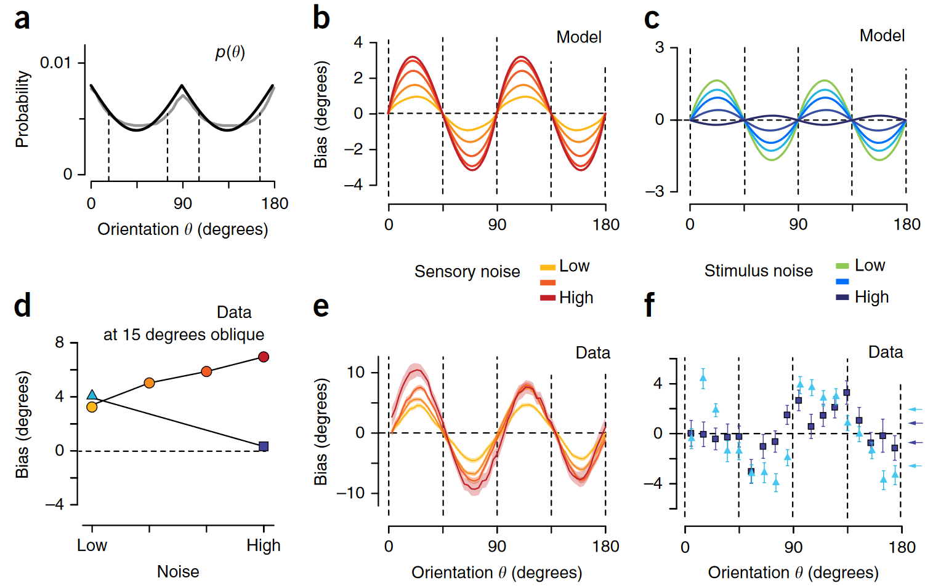
Results

Slide 8
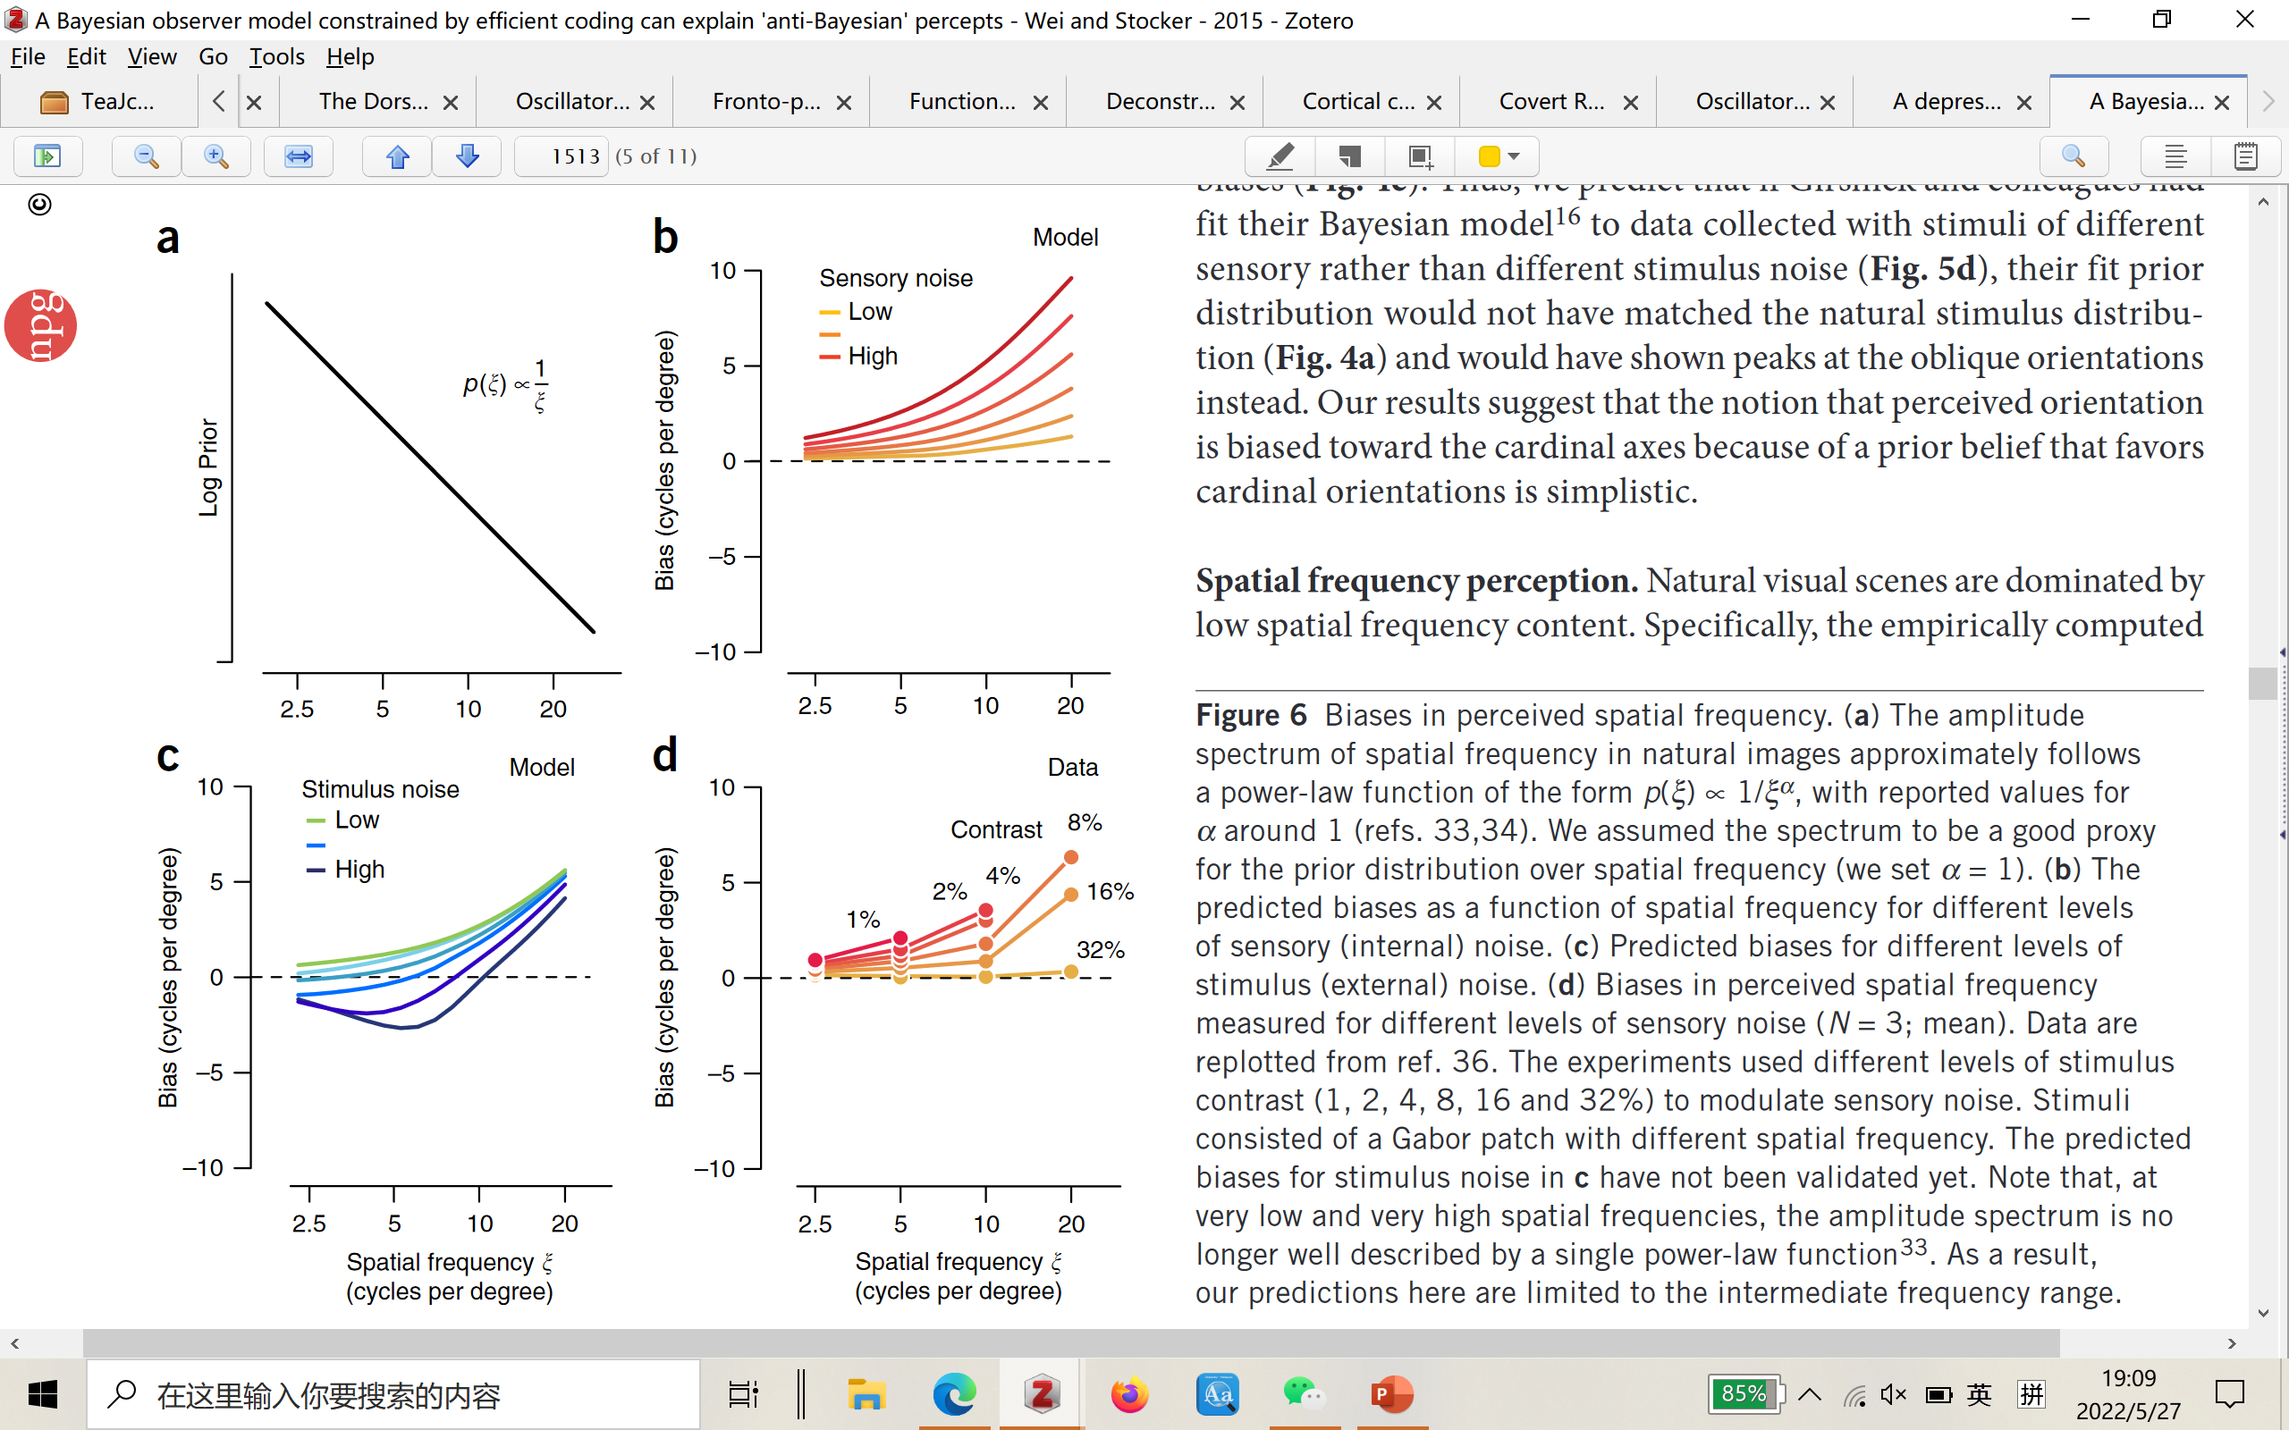
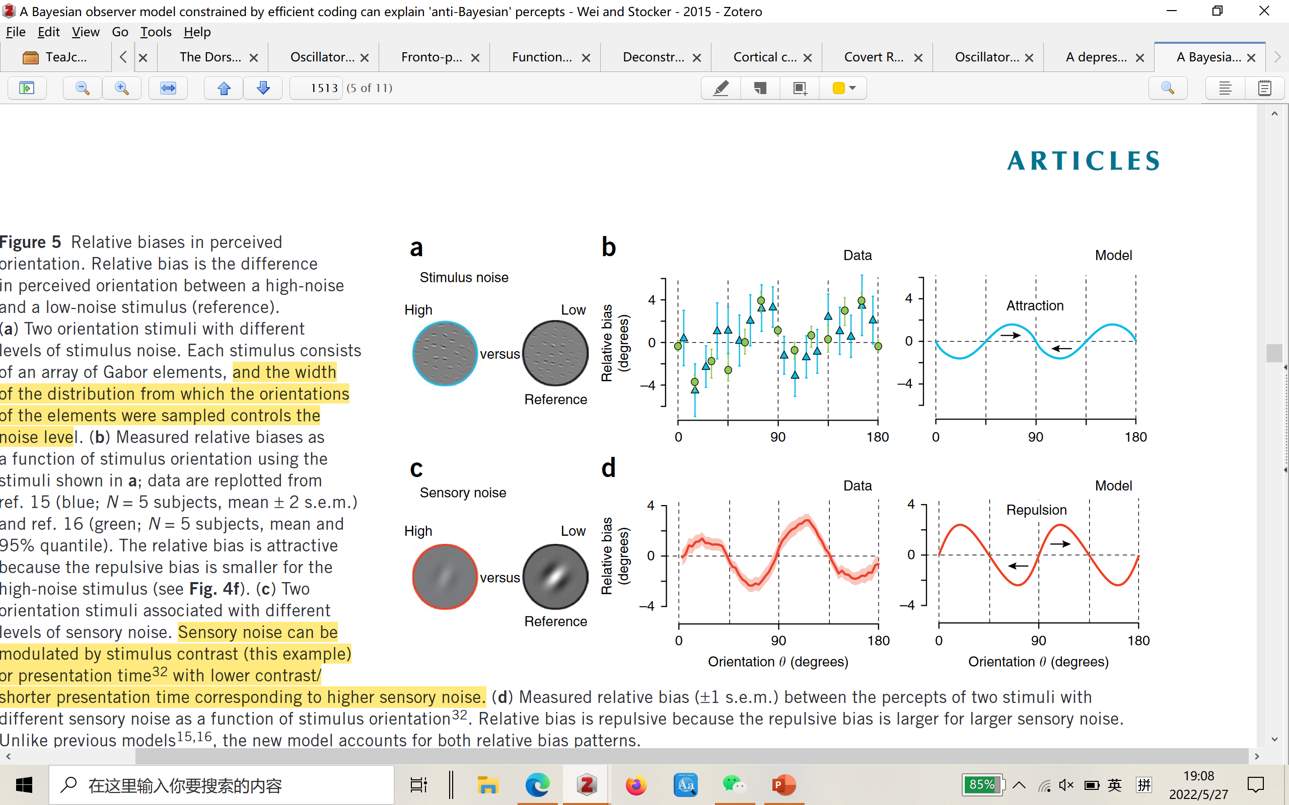
Results

Slide 9
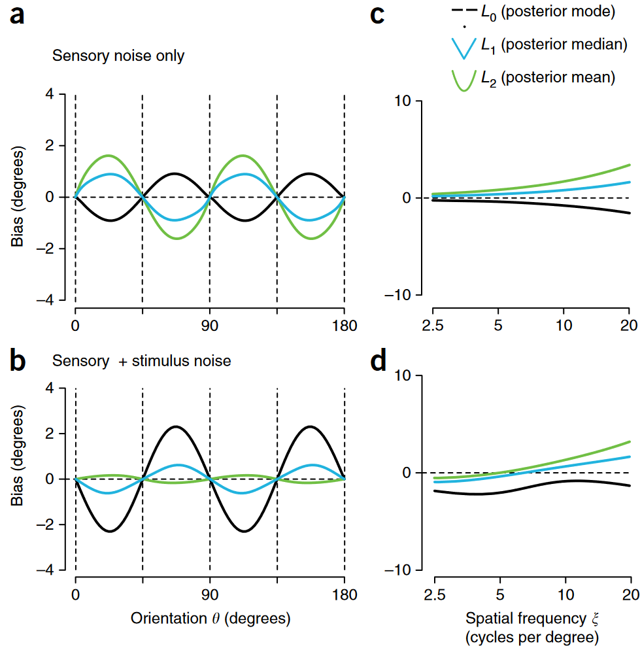
Results
Both the L1 and L2 norm predict repulsive biases, whereas the L0 norm always leads to attractive biases
Adding stimulus noise reduces the likelihood asymmetry and thus increases the attractive influence of the prior.

Slide 10
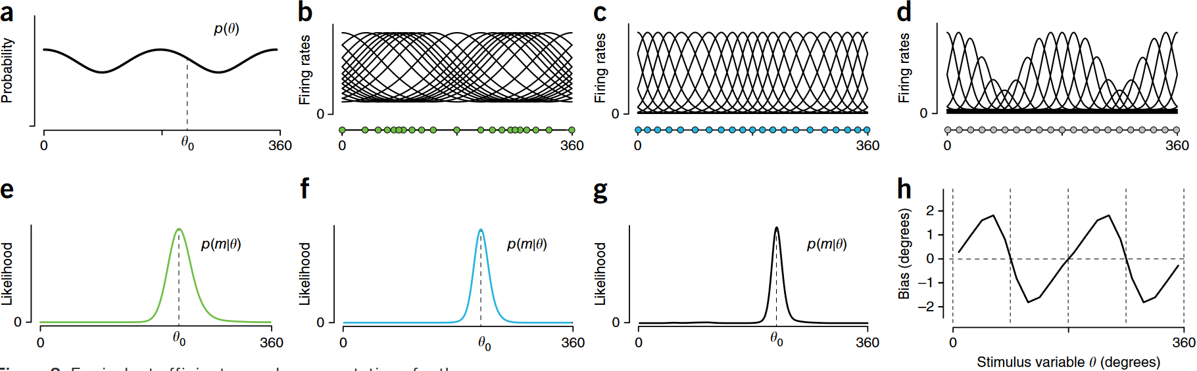
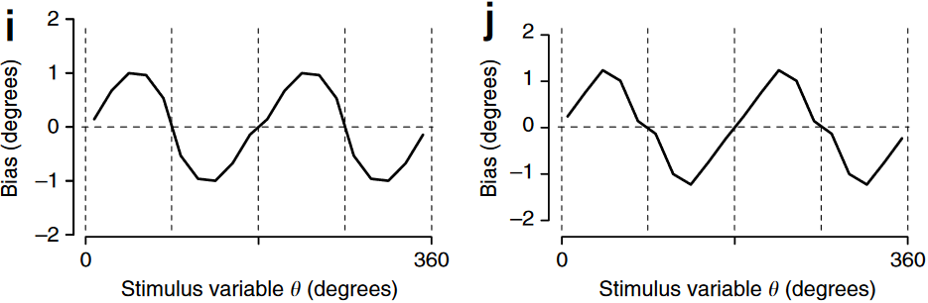
Physiological Instantiation

